Slide 1



From Data to Decision-Making
Information Delivery Services (IDS) Project
&
Getting It System Toolkit
IDSProject.org
2010
1

Slide 2


























































Jan. 2011
59 Libraries (academic, medical, public, special)
Student Head-Count: ~ 330,000
Faculty Head-Count: ~ 17,500
Total Volumes: ~ 33,000,000
CUNY
Notes:
Updated 10-21-10

Slide 3

A unified community of trust and support built around a critical and clearly understood common purpose: effective resource sharing.
This is a People Project
focused on shared continual improvements & innovation.
2010
3

Slide 4


Turn-Around Time (TAT) matters to users…
TAT defined as:
The time from when user places a request until the time the user is notified the loan is ready for pickup or the article is ready to be retrieved from the Web.
2010
4
Notes:
Another part of the Project’s strategy was to define how we would measure the turnaround time of an ILL transaction.

Slide 5
Performance standards
Articles: 48 hours
Loans: 72 hours
(Weekends and Holidays Excluded)
2009
5
Notes:
These are the IDS Project benchmarks for resource sharing.

Slide 6
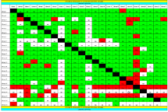
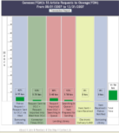
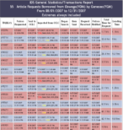
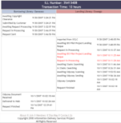
IDS Transaction Performance Analysis Module (TPAM)
Now also being used by Maryland IDS, & Kudzu/ASERL
2010
6
Notes:
TIM
TPAM provides libraries with a series of hierarchically linked charts.

Slide 7
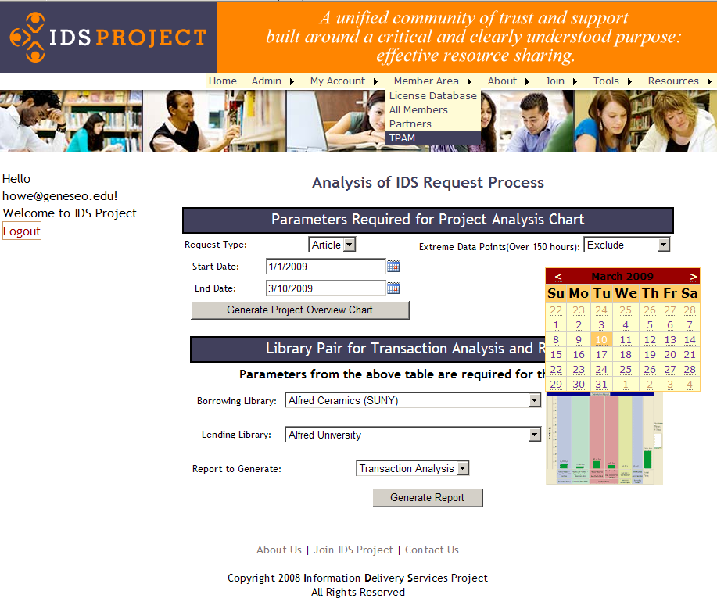
7

Slide 8
Project Overview Chart
Borrowing Library : 10
Lending Library: 13
18.1 hours for 5 Article(s)
2010
8

Slide 9
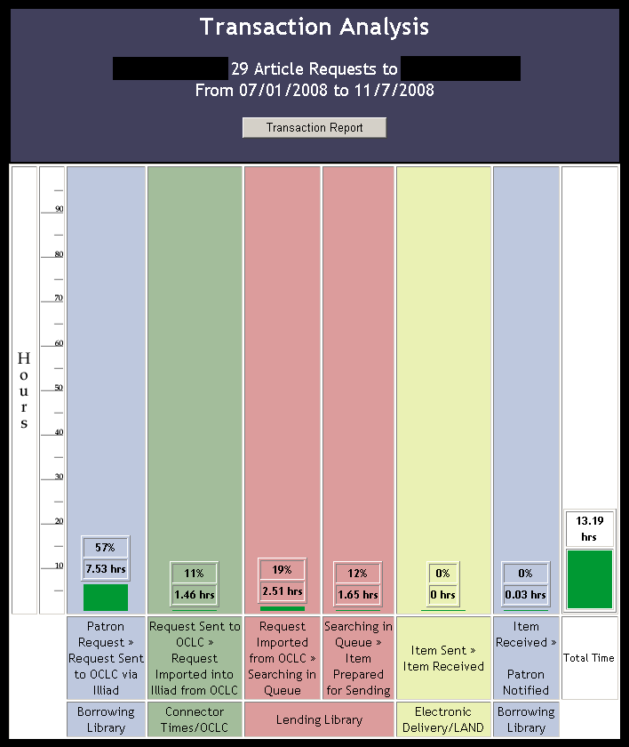
Library 1
Library 2
2010
9

Slide 10
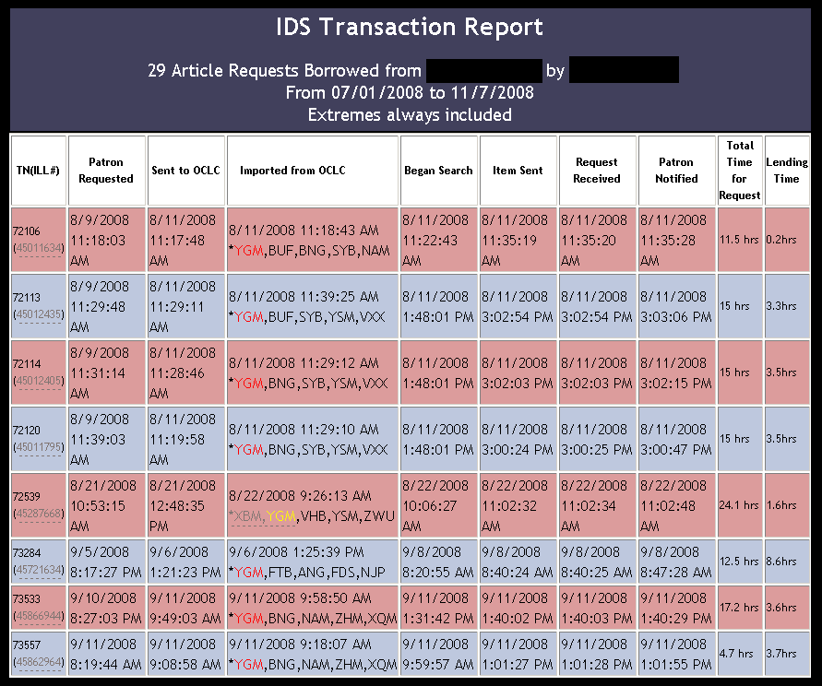
Library 1
Library 2
2009
10

Slide 11
Question
What are your shared benchmarks?
and how do you measure performance?

Slide 12
Data helps… but what next… continually & effectively improve our
Tools & Workflow – How?

Slide 13

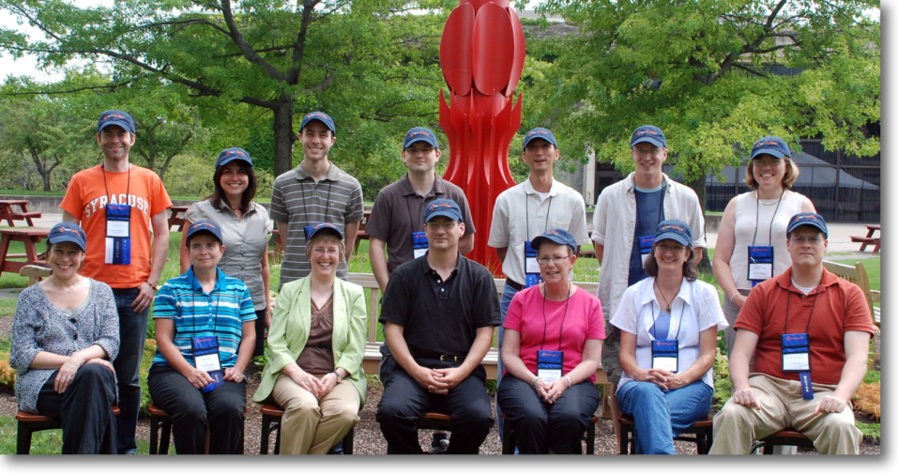

IDS Project Mentors 2010
Back row (l-r): Mike Curtis (Upstate University Health System), Kerry Keegan (Stony Brook), (Tim Bowersox, (Geneseo), Mike Mulligan (Upstate University Health System), Corey Ha (Geneseo), Adam Traub (St. John Fisher), Pam Flinton (Oneonta)
Front row (l-r): Beth Posner (CUNY Graduate Center), Janet Ferry, retired, (Fredonia), Michelle Parry, former, (Oswego), Mark Sullivan (Geneseo) , Karen Gardner-Athey (SUNY OLIS). Christine Sizak (Nazareth) Kevin Reiss (The City University of New York), and (no picture) Andy Perry (Oneonta)
Notes:
Cyril
One of the successful strategies – mentor teams, was only thought of recently. Basically, a TRAINED TEAM of volunteer mentors – applications and technical mentors are available to libraries joining the project.
This compliment of technical and application/practical workflow competencies ensures maximum transfer and exchange of knowledge required to improve resource sharing significantly.
Mentor teams visit libraries – to help with ILLiad post-installation workflow training, implementing various IDS workflow and resources, as well as troubleshooting various technical issues that library staff want to address. New IDS Project libraries are encouraged to visit other IDS Project libraries to evaluate workflow options.

Slide 14
Mentor Program
  Team of volunteers from member libraries
  Workflow & systems specialists
  Helps new libraries prepare for active participation
  Provides all members with ongoing support and training
  On-site training & remote support available
  Documentation or Knowledge Base & online community needed…

Slide 15
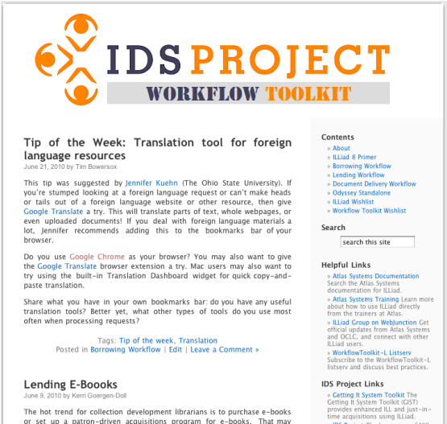
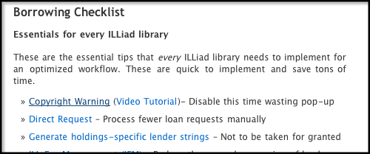
Workflow Toolkit
  Repository of ILLiad best practices
  Helps you...
    Simplify your workflows
    Save staff time
    Cut ILL costs
  Supported by the ILLiad user community
    Dedicated listserv
    Blog posts
    Sharing tools & ideas
  Partnership with Atlas Systems

Slide 16
Mentor Training Institute
  Prepares new volunteers to become mentors
    Formal application process
    Each volunteer must have their director's endorsement
  8 sessions culminating in a graduation ceremony at the annual IDS Project Conference
    Borrowing & lending best practices
    Implementation of IDS technologies
    Training skills & mentoring preparation
  Fellows become Certified IDS Project Mentors
  Provides ongoing training & skills development to all mentors

Slide 17
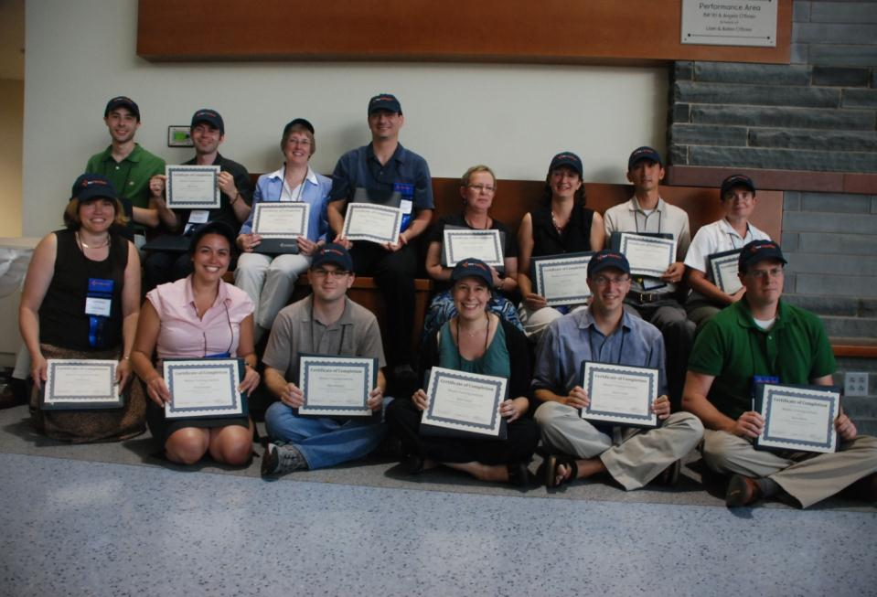
How do we train for every library being a mentor?
17

Slide 18
ALIAS
Article Licensing Information Availability Service
Shared Innovation Development
2010
18
Notes:
CYRIL

Slide 19
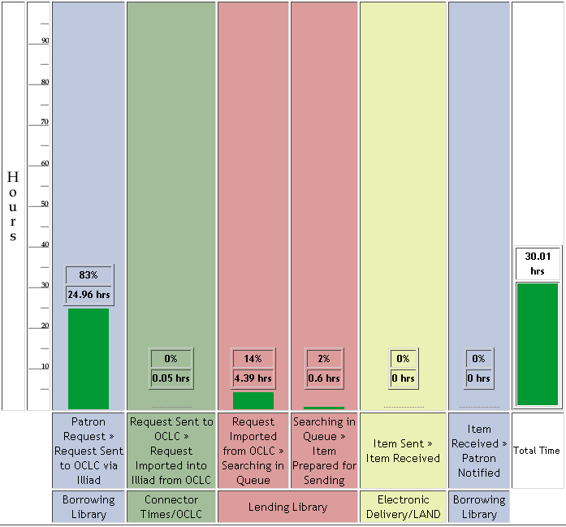
Unmediated requesting eliminates 1 day delay
Pre-ALIAS Article Borrowing
25 hours (avg.) before requests sent to Lending Library
Total turnaround time: 30 hours (avg.)
ALIAS can reduce sending time to: 8 hours (avg.)
http://www.atlas-sys.com/company/newsletter/archive/OracleNewsletterWinter2009.pdf
Notes:
The much needed improvement was to reduce the processing time that articles took on the borrowing side – we wanted direct request for articles, and this Transaction Performance Analysis Module shows the average times for ILL pre-processing was well worth our time to unmediate requesting.
This project was called ALIAS – Article Licensing Information Availability Service. As you will see, we are big on acronyms.

Slide 20
Article Licensing Information Availability Service (ALIAS)
Partnering with Atlas Systems, Inc.
Patron Request
IDS Service
Query ISSN, date
ILLIAD
ALIAS: Licensing Database
Awaiting Request Processing – Manual Process
Article Direct Request – Automatic Process
Library Codes for valid dates and licenses
Request Sent to OCLC
Local Holdings Queue
Notes:
We partnered with Atlas Systems to enhance the ejournal availability service with much needed automation.
Outline process
The IDS Service was developed by wonderful Atlas Staff to help us accomplish what we set out to do.
The IDS Service runs every 60 sec. automating the requesting process and discovery of materials we own – yes, even with open URL resolvers, we still get 10% requests for materials we own. At our request, Atlas solved another big problem with traditional ILL process – the problem of load leveling…

Slide 21
ALIAS Time Comparisons
Library | Requests | Avg. Hours before sent on OCLC | Requests | Av. Hours sent using ALIAS | Percent Reduced Sending Time
City College | 687 | 14 | 131 | 1 | 93%
College of Staten Island | 992 | 10.5 | 199 | 1.5 | 86%
CUNY Graduate Center | 6166 | 11.1 | 1543 | 1.8 | 84%
Geneseo | 2365 | 17 | 2446 | 2.5 | 85%
Notes:
http://www.oclc.org/news////releases/200929.htm

Slide 22

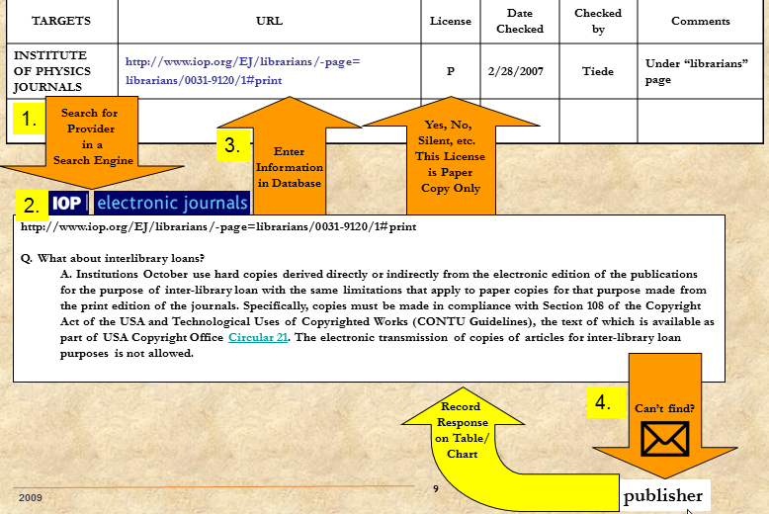
Generic License Management http://idsproject.org/documents/IDS%20Project%20licensing.pdf
Over 20 librarians from 12 libraries cooperatively update this system each year.
Data also available to ILLiad addons.

Slide 23
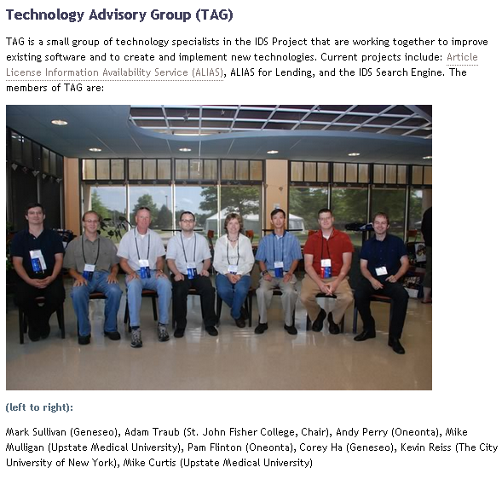
Technology Advisory Group
Technology Advisory Group http://idsproject.org/About/TAG.aspx
Current projects
IDS Search
Getting It System Toolkit
ALIAS
ILLiad Addons
TPAM 2
& more…

Slide 24

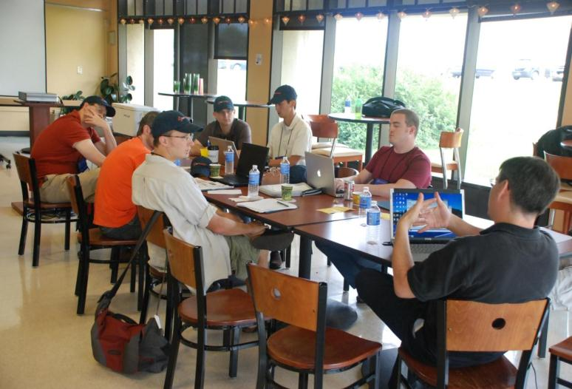

Technology Advisory Group (TAG)
24
Notes:
One of the successful strategies – mentor teams, was only thought of recently. Basically, a TRAINED TEAM of volunteer mentors – applications and technical mentors are available to libraries joining the project.
This compliment of technical and application/practical workflow competencies ensures maximum transfer and exchange of knowledge required to improve resource sharing significantly.
Mentor teams visit libraries – to help with ILLiad post-installation workflow training, implementing various IDS workflow and resources, as well as troubleshooting various technical issues that library staff want to address. New IDS Project libraries are encouraged to visit other IDS Project libraries to evaluate workflow options.

Slide 25
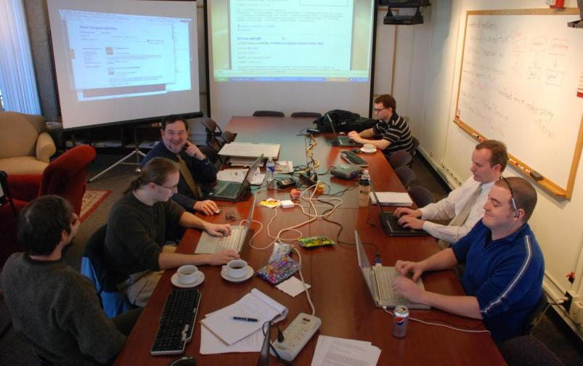
IDS Search Team
Mike Curtis, Project Manager (Upstate University Health System), Adam Traub (St. John Fisher), Ed Rivenburgh (Geneseo), Mike Mulligan (Upstate University Health System), Cyril Oberlander (Geneseo), Nathan Fixler (SUNY OLIS), Kevin Reiss (CUNY)
25

Slide 26
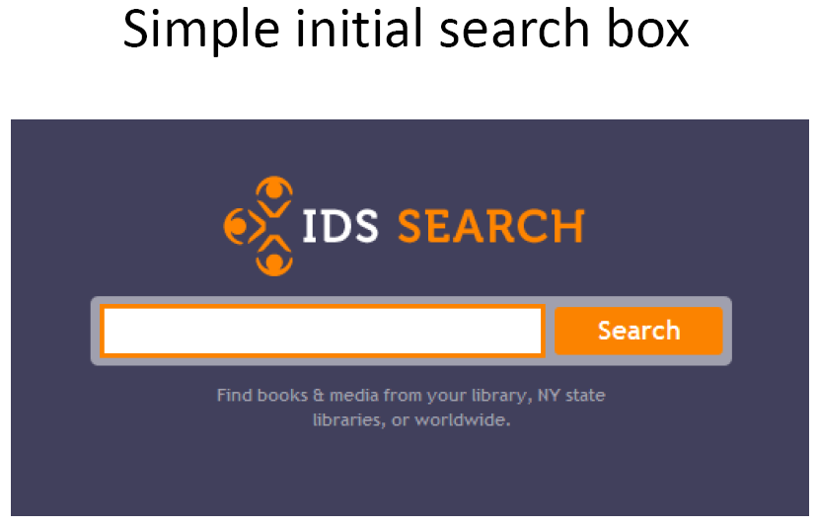

Slide 27
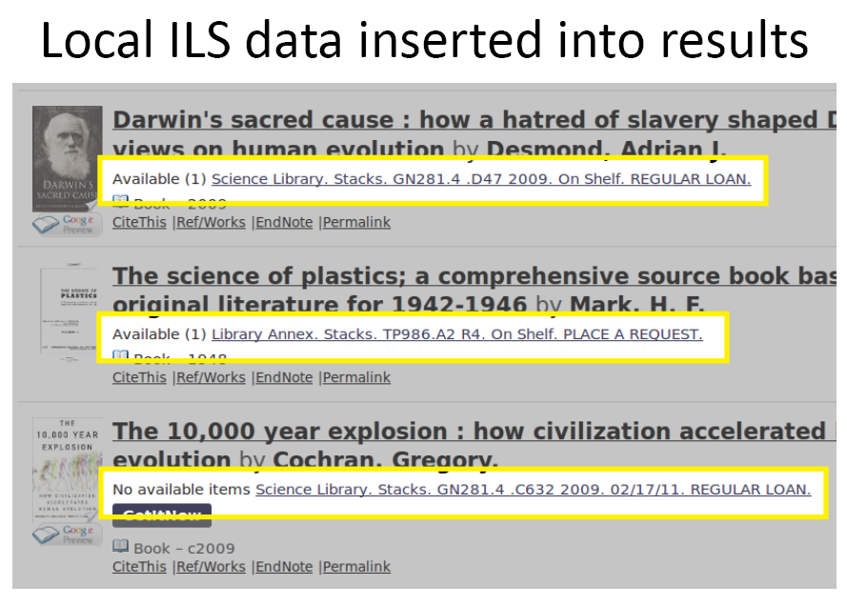

Slide 28
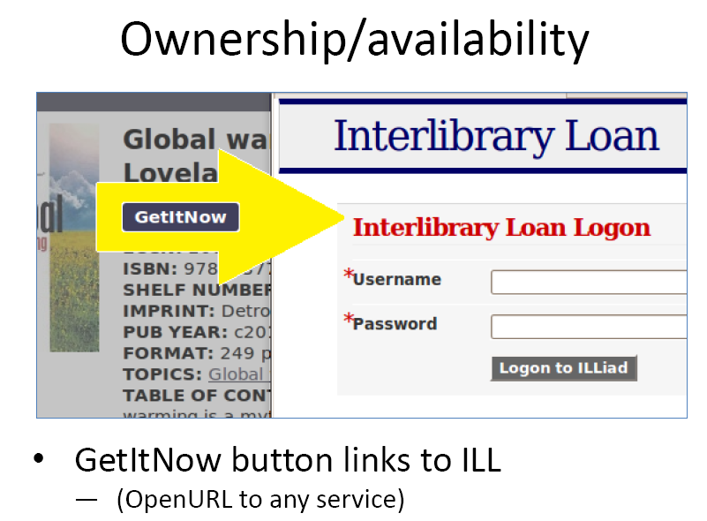

Slide 29
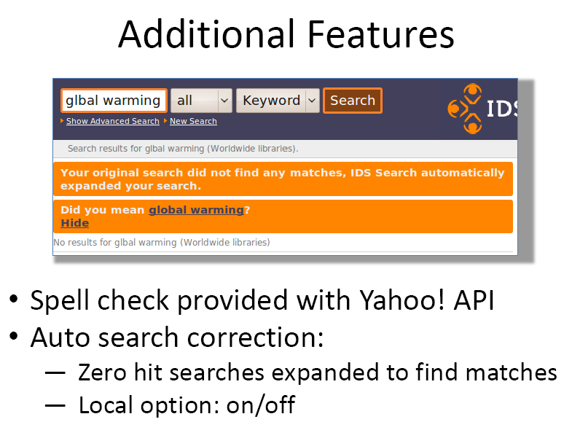

Slide 30
Seeking Shared Innovation
What are significant needs for innovation?
How can we effectively work together to share and implement innovative solutions?

Slide 31
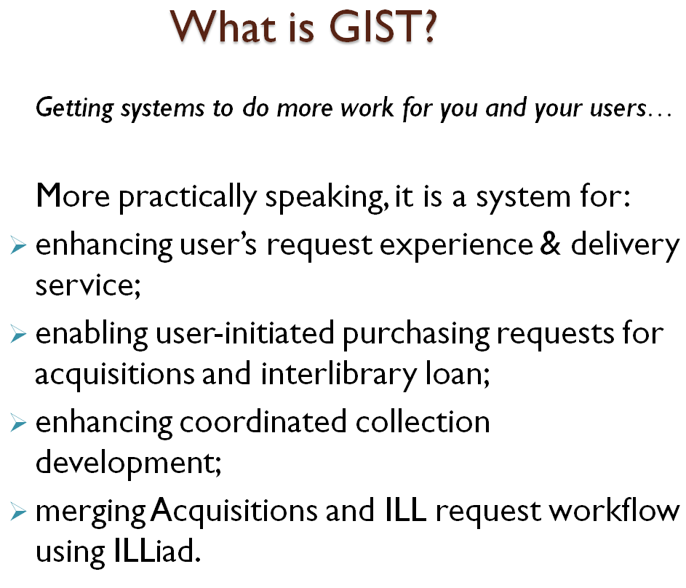
Getting It System Toolkit (GIST)

Slide 32
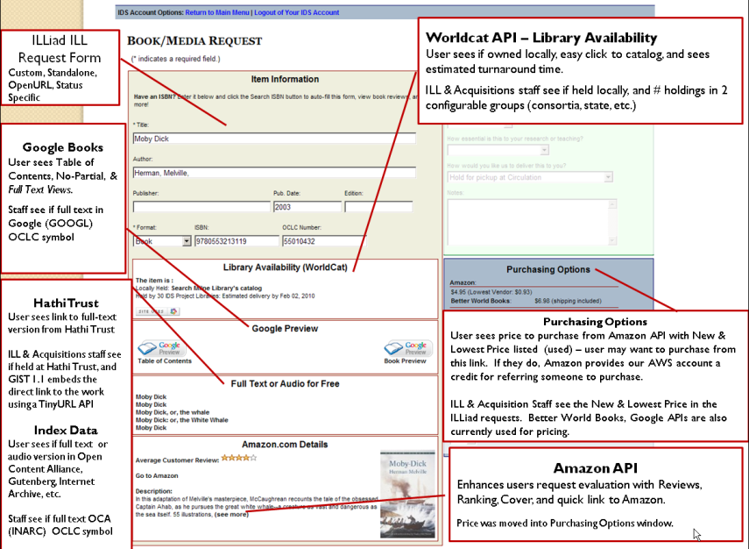
GIST User Interface
What is
useful to users?

Slide 33
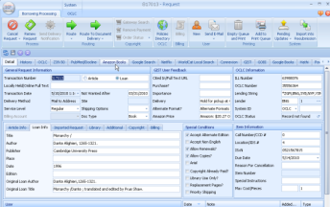
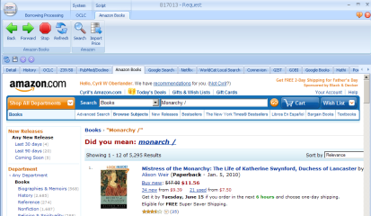
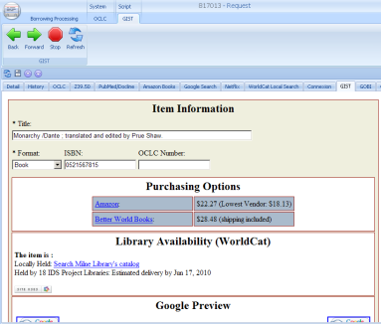
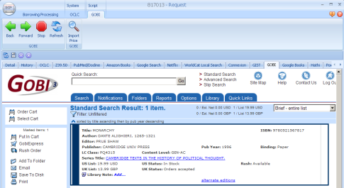
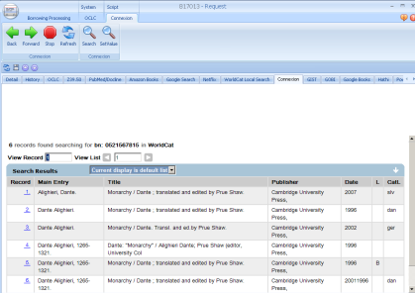
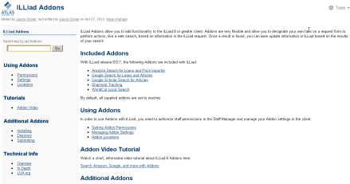
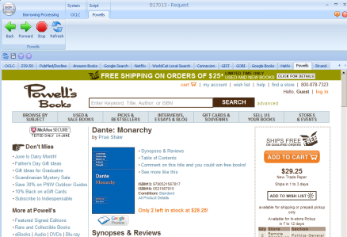
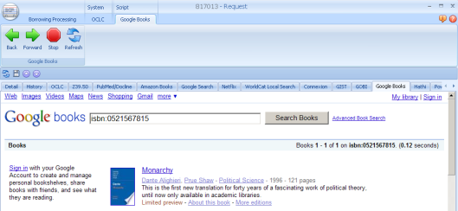
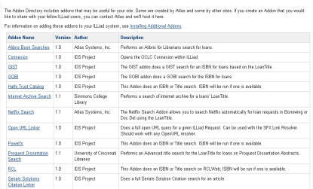
GIST & ILLiad Addons
Connect any web service to your workflow:
Amazon, GIST, GOBI, OCLC Connexion, RCL Web…
What is useful to staff?
A tab away
ILLiad Addons https://prometheus.atlas-sys.com/display/ILLiadAddons/Addons+Directory

Slide 34
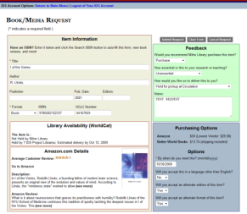
GIST
ILL & ACQ Workflow
What is the future of ILL & Acquisitions?
GIST Request
Interlibrary Loan / IDS
Cancel or Unfilled
Filled
Borrow
Acquisitions
Filled
Buy
Cancel or Borrow
Requests are Transferable

Slide 35
Latest research & development work with GIST ILLiad addons…
Purchasing articles…

Slide 36
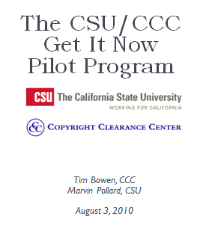
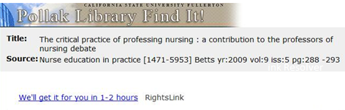
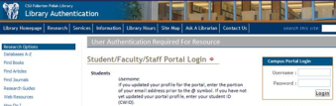
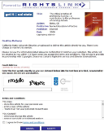
CCC Get It Now Service
1. OpenURL resolver directs users to CCC Get It Now Service
2. User authenticates
3. User enters email
4. Accepts Terms & Conditions
5. Submits Request
6. Receives material via email within 2 hours.
Presentation available at:
http://idsproject.org/conferences/2010/index.aspx
24 x 7 end-user service to buy articles
Library is billed monthly
Avg. turnaround time is less than 3 minutes
Unmediated & mediated options

Slide 37
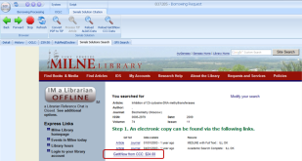
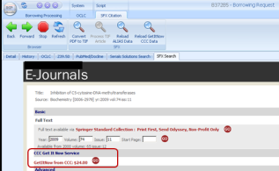
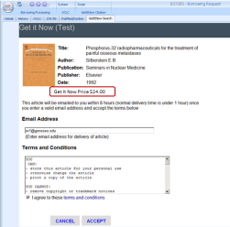
Staff mediated CCC Get It Now Service with your choice of GIST ILLiad Addons
Serials Solutions Addon
SFX Addon
CCC Get It Now Addon
Under development – see details at
International ILLiad Conference March 2011

Slide 38

CCC Get It Now Service
& GIST ILLiad Serials Solutions Addon

Slide 39

CCC Get It Now Service
& GIST ILLiad SFX Addon

Slide 40

CCC Get It Now Service GIST ILLiad Addon
Addon tab appears only if article is available from the CCC Get It Now Service

Slide 41
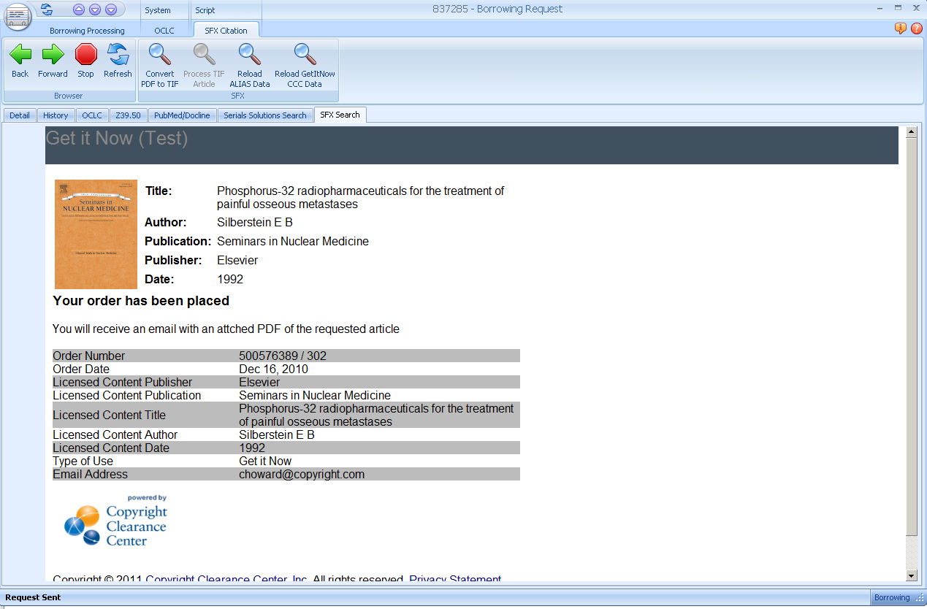
Order confirmed
Delivery in about 3 minutes (within 2 hours)
Cost effective
Pay by invoice
24 x 7 service
Safeguards; authorized users only, check for duplicates & multiple order limits
  Tim Bowen
  Product Manager
  Copyright Clearance Center
  978-646-2592
  tbowen@copyright.com

Slide 42
What will the GIST Team release this August?
Acquisitions Manager
Updated GIST for ILLiad Webpages

Slide 43
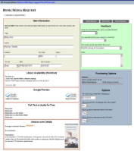
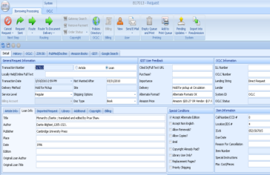
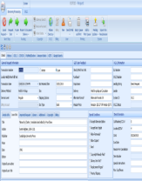
GIST Acquisitions Manager
Hold for Pickup
Mail to Address
Place on Reserve
Shelve it
Other?
Purchasing
Price Check
GIST Addon: Amazon, Alibris, BWB, GOBI, You select your vendor
Ordering Process
GIST Addon: Fund Manager Interface
Check current FUNDS (associated with username, department, and general purpose), import current FUNDS.
Apply FUNDS in real time.
Purchasing Process
Amazon Addon: (one example)
Import Order Total, Order Number, Estimated shipping date, Delivery URL
Print Procurement Form – institution specific (addon &/or report)
Holdings Process
OCLC Addon: Open OCLC Connexion – search, import LC#.
ILS Addon: Create Hold? (long-term TAG project)
Funds
Configure visibility as appropriate: On/Off,
Username & Funds,
Dept – General Fund,
Description: Radio button w/name & totals
Receiving Process
Depending on if library adds holdings at point of order…
Holdings Process
OCLC Addon: Open OCLC Connexion – search, import LC#.
ILS Addon: Create Hold?
Review Process
Email Routing
Send to Reviewer:
Link to GIST-Like Form to see CURRENT Budgets (FUNDS) and trigger Approve / Do Not Approve
Email reply triggers action via EmailImport
Notes:
Cyril

Slide 44
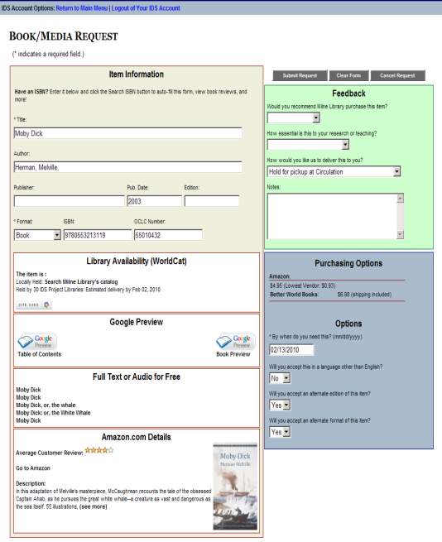
GIST User Interface Scenario: Fund selection & insufficient funds
Purchasing transparency (on/off?)
Purchasing Options (Status & username specific) with Acquisitions Manager data: only faculty may see their department and if applicable username specific budgets; library staff in GIST addon see all budgets and can apply changes for import – see next slide.
Cost:
Amazon $4.95 (Lowest Vendor: $0.09)
Better World Books $6.49 (shipping included)
Budget: Select budget applied to this recommendation:
History General $553 remaining
Urban History Project Grant $58 remaining
Conditional business rule; if assigned budgets are depleted (or end of year) – system routing applies or librarian review web interface.
Insufficient funds - Recommend for next year or if additional funding is available.
Fiscal year ended - Recommend for next year’s budget.
Donate funds?

Slide 45
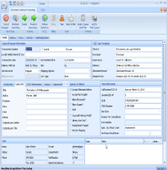
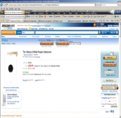
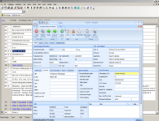
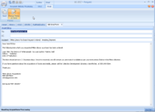
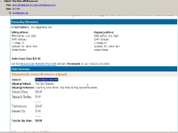
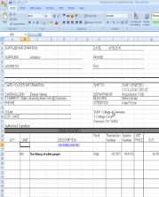
Basic Scenario of Purchasing Amazon order
User updated on purchasing
OCLC Addon: import record, attach symbol, and add call number after cataloging in OCLC. Import record in ILS?
Use GIST Addon to check funding; user designated and related funding options and budgets
Purchase from Amazon, import shipping fee (3rd party), Price, order #, YBP if purchased from GOBI, (shipping URL/Tracking & expected date nice to have).
Review Process
Email Routing or Web Interface
Send to Reviewer:
Link to GIST-Like Form to see CURRENT Budgets (FUNDS) and trigger Approve / Do Not Approve
Email reply triggers action via EmailImport
Customizable Print Forms
Print procurement or other forms using MS Access or Addon.

Slide 46

Documentation & downloads @ http://gist.idsproject.org

Slide 47

IDS PROJECT.ORG
Do we have the individual and collective will to meet today’s users’ demands for information by dramatically transforming the current operations within our individual libraries—and by radically reshaping the historic organizational relationships among our libraries?
2009
47
Notes:
The IDS Project is built around this challenge.
To answer this question in the affirmative require that we confront and embrace two very scary ideas:

Slide 48

IDS 2010
To The Seventh Annual
Information Delivery
Services (IDS)
Summer Conference!
Oswego, NY
August 3-4, 2010
Notes:
IDS Project offers member and even guests, high quality and very inexpensive two day summer conference.
You are invited.

Slide 49

49

Slide 50

50

Slide 51



Mentors at work
51

Slide 52





Slide 53





Slide 54
Welcome!
To The Eighth Annual
Information Delivery
Services (IDS)
Summer Conference!
August 2-3, 2011
Albany, NY
Notes:
IDS Project offers member and even guests, high quality and very inexpensive two day summer conference.
You are invited.

Slide 55
Important questions for us…

Slide 56
Important questions for us…
People first
What must we do to prepare us (new and seasoned) ILL personnel with the growing technical competencies required to manage ILL?
  What strategies work at your library or region?
  “your library is my library, my library is your library”
  Proposal/Resolution to consider…
  Visit your neighbor
  Share your expertise & learn

Slide 57
Important questions for us…
As ebooks lock away lending rights, and print library collections decrease (weeding & reduced print monograph spending) – what is the impact and strategies for ILL?
  Continuously growing consortia, i.e. reciprocal partners?

Slide 58
Important questions for us…
Purchasing and borrowing workflow converge – what are effective strategies to combine strengths of acquisitions, collection development, and interlibrary loan?

Slide 59
Last questions
Do you have suggestions for the GIST Team?
Discuss now or email cyril@geneseo.edu
Do you have suggestions for the IDS Project?
Discuss now or email edr@geneseo.edu

Slide 60


IDSProject.org
Check out our
Strategic Plan
IDS Project Contact Information
Project Director | Ed Rivenburgh | edr@geneseo.edu | 585-245-5591
Internal Project Consultant | Cyril Oberlander | cyril@geneseo.edu | 585-245-5528
Systems Administrator | Mark Sullivan | sullivm@geneseo.edu | 585-245-5698
Web Master | Corey Ha | ha@geneseo.edu | 585-245-5584
Coordinator of Mentors & Training | Tim Bowersox | bowersox@geneseo.edu | 585-245-5589
2009
60

